Slide 1
Sorting Algorithms Examples
PEMP-CSN2501
Data Structures & Algorithms
HND CSD
BCAS Campus, Kalmunai

Slide 2
Textbook
C & Data Structures
P. S. Deshpande, O. G. Kakde
CHARLES RIVER MEDIA, INC. Hingham, Massachusetts

Slide 3
List of Various Sorting Algorithms
PEMP CSN2501
Bubble Sort Selection Sort Insertion Sort Merge Sort Quick Sort Heap Sort
N D Gangadhar MSRSAS
©M.S.Ramaiah School of Advanced Studies - Bangalore

Slide 4
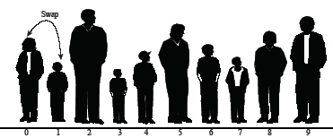

1. BUBBLE SORT
Bubble sort: beginning of first pass

Slide 5


1. BUBBLE SORT

Slide 6

1. BUBBLE SORT
Bubble sort: end of First pass

Slide 7
Trace of a Bubble Sort
PEMP CSN2501
I Pass
A[0] = 40
A[1] = 50
A[2] = 30
A[3] = 20
A[4] = 10
40
50
30
20
10
40
30
50
20
10
40
30
20
50
10
N D Gangadhar MSRSAS
©M.S.Ramaiah School of Advanced Studies - Bangalore

Slide 8
contd…Trace of a Bubble Sort
PEMP CSN2501
II Pass
III Pass
IV Pass
Sorted Array
40 30
30 40
20 20
10 10
50 50
30
20
40
10
50
30 20
20 30
10 10
40 40
50 50
20
10
30
40
50
10
20
30
40
50
N D Gangadhar MSRSAS
©M.S.Ramaiah School of Advanced Studies - Bangalore

Slide 9
Trace of a Selection Sort
PEMP CSN2501
I
05
20
40
45
15
25
50
35
30
10
II
05
10
40
45
15
25
50
35
30
20
III
05
10
15
45
40
25
50
35
30
20
IV
05
10
15
20
40
25
50
35
30
45
V
05
10
15
20
25
40
50
35
30
45
VI
05
10
15
20
25
30
Passes ◊
A[0] = 45
A[1] = 20
A[2] = 40
A[3] = 05
A[4] = 15
A[5] = 25
A[6] = 50
A[7] = 35
A[8] = 30
A[9] = 10
50
35
40
45
N D Gangadhar MSRSAS
©M.S.Ramaiah School of Advanced Studies - Bangalore

Slide 10
contd….Trace of a Selection Sort
PEMP CSN2501
VII
05
10
15
20
25
30
35
50
40
45
VIII
05
10
15
20
25
30
35
40
50
45
IX
05
10
15
20
25
30
35
40
45
50
Sorted Array
05
10
15
20
25
30
35
40
45
50
N D Gangadhar MSRSAS
©M.S.Ramaiah School of Advanced Studies - Bangalore

Slide 11

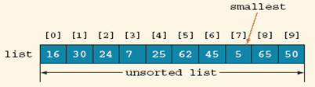
Example For Selection Sort

Slide 12
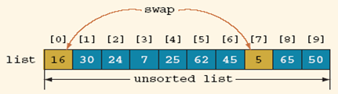
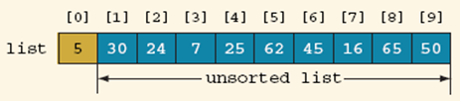
Example For Selection Sort

Slide 13
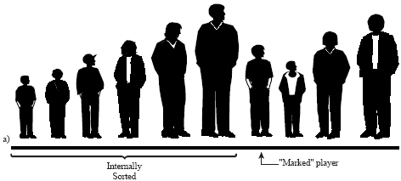
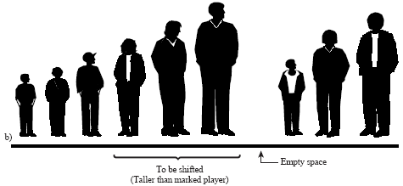
3. INSERTION SORT

Slide 14
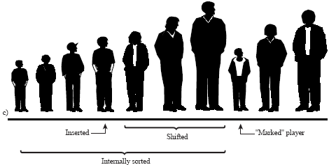
3. INSERTION SORT

Slide 15
Trace: Insertion Sort
PEMP CSN2501
a[0] = 20
a[1] = 10
a[2] = 30
a[3] = 15
a[4] = 25
a[5] = 05
10
20
30
15
25
05
10
15
20
30
25
05
10
15
20
25
30
05
05
10
15
20
25
30
10
20
30
15
No
change
25
05
N D Gangadhar MSRSAS
©M.S.Ramaiah School of Advanced Studies - Bangalore

Slide 16
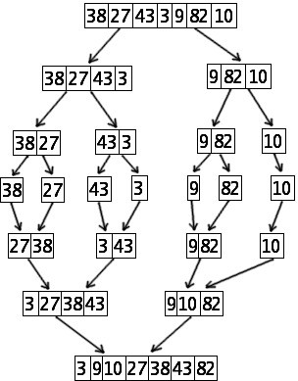
Trace of a Merge Sort
PEMP CSN2501
N D Gangadhar MSRSAS
©M.S.Ramaiah School of Advanced Studies - Bangalore

Slide 17
Trace of a Quick Sort
PEMP CSN2501
low
i
high, j
42 | 37 | 11 | 98 | 36 | 72 | 65 | 10 | 88 | 78
42>37 so, i++
i
42 | 37 | 11 | 98 | 36 | 72 | 65 | 10 | 88 | 78
42>11 so, i++
i
42 | 37 | 11 | 98 | 36 | 72 | 65 | 10 | 88 | 78
42>98 stop, i++, & compare 42 with a[j] = 78
42<78 so, j--
i
42 | 37 | 11 | 98 | 36 | 72 | 65 | 10 | 88 | 78
N D Gangadhar MSRSAS
©M.S.Ramaiah School of Advanced Studies - Bangalore

Slide 18
Trace of a Quick Sort
PEMP CSN2501
i
j
42 | 37 | 11 | 98 | 36 | 72 | 65 | 10 | 88 | 78
42<88 so, j--
i
42 | 37 | 11 | 98 | 36 | 72 | 65 | 10 | 88 | 78
42<10 stop, j--
Since i<j, exchange a[i] with a[j] and repeat the process
i j
42>10 so, i++
i
42>36 so, i++
42 | 37 | 11 | 10 | 36 | 72 | 65 | 98 | 88 | 78
N D Gangadhar MSRSAS
42 | 37 | 11 | 10 | 36 | 72 | 65 | 98 | 88 | 78
©M.S.Ramaiah School of Advanced Studies - Bangalore

Slide 19
Trace of a Quick Sort
i j
PEMP CSN2501
42 | 37 | 11 | 10 | 36 | 72 | 65 | 98 | 88 | 78
42>36 so, i++
i
j
42 | 37 | 11 | 10 | 36 | 72 | 65 | 98 | 88 | 78
42>72 stop, i++, & compare 42 with a[j] = 98
i
j
42 | 37 | 11 | 10 | 36 | 72 | 65 | 98 | 88 | 78
42<98 so, j--
i
j
42 | 37 | 11 | 10 | 36 | 72 | 65 | 98 | 88 | 78
42<65 so, j--
N D Gangadhar MSRSAS
©M.S.Ramaiah School of Advanced Studies - Bangalore

Slide 20
Trace of a Quick Sort
i,j
PEMP CSN2501
42 | 37 | 11 | 10 | 36 | 72 | 65 | 98 | 88 | 78
42<72 so, j--
j
i
42 | 37 | 11 | 10 | 36 | 72 | 65 | 98 | 88 | 78
42<36 FALSE
Since i exceeds j, exchange a[low] with a[j].
j i
low
42 | 37 | 11 | 10 | 36 | 72 | 65 | 98 | 88 | 78
N D Gangadhar MSRSAS
©M.S.Ramaiah School of Advanced Studies - Bangalore

Slide 21
Trace of a Quick Sort
PEMP CSN2501
The sorted array after partition
36 | 37 | 11 | 10 | 42 | 72 | 65 | 98 | 88 | 78
<42
>42
Pivot Element
N D Gangadhar MSRSAS
©M.S.Ramaiah School of Advanced Studies - Bangalore

Slide 22
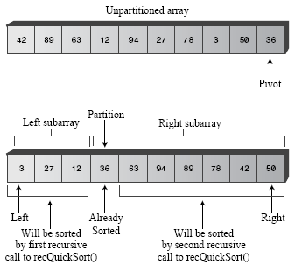
Example for Quick Sort

Slide 23
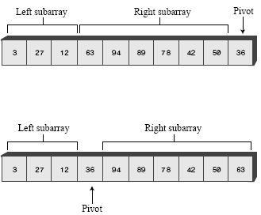
Example for Quick Sort

Slide 24
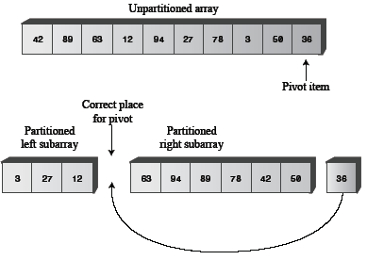
Example for Quick Sort

Slide 25
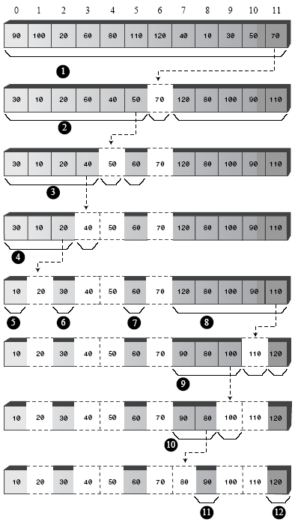
4. QUICK SORT

Slide 26
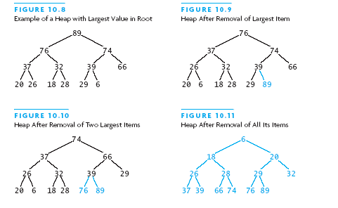

Slide 27
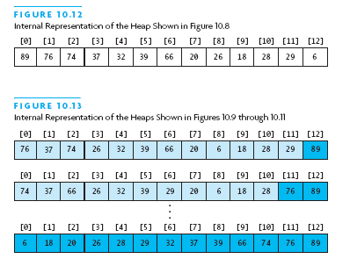

Slide 28
THANK YOU!
BY: Eng. A.L. Jubailah Begum

